Slide 1

Safe Cyclist / Pedestrian Routing System
Team: Group 2
Team Members:
D24126339 – Huda Ibrahim
D24125555 – Karan Joseph
D24126048 – Shalini Kuruguntla
D24125575 – Sai Priyanka Basa Shanker
D24127853 – Hina Kausar

Slide 2
Problem Statement
Current navigation apps focus only on shortest route
Safety risks ignored (crime, traffic, poor infrastructure, weather)
Vulnerable users face potential risks (women at night, elderly, cyclists
Notes:
Current apps like Google Maps only optimize for speed and distance. They ignore critical risks like crime, traffic accidents, or poor infrastructure. This leaves vulnerable users exposed — for example, women walking home at night or cyclists without safe bike lanes

Slide 3
Why This Matters
Gap in safety-aware navigation tools
Supports NYC Vision Zero & safer streets
Provides data-driven insights for urban planning
Notes:
Supports NYC Vision Zero & safer streets means
Vision Zero is New York City’s official traffic safety program (launched in 2014).
Its goal: eliminate all traffic deaths and serious injuries on NYC streets through better street design, lower speed limits, more enforcement, and data-driven safety improvements.
Your project directly aligns with this because it helps pedestrians and cyclists avoid dangerous areas, accidents, and poorly designed streets → which contributes to the same mission of safer mobility for all.
This problem is bigger than convenience, it’s about public safety. Our system fills the gap by making safety part of route planning. It also supports NYC’s Vision Zero program, which aims to eliminate traffic deaths and injuries. Beyond individual users, our system can also provide valuable insights to urban planners

Slide 4
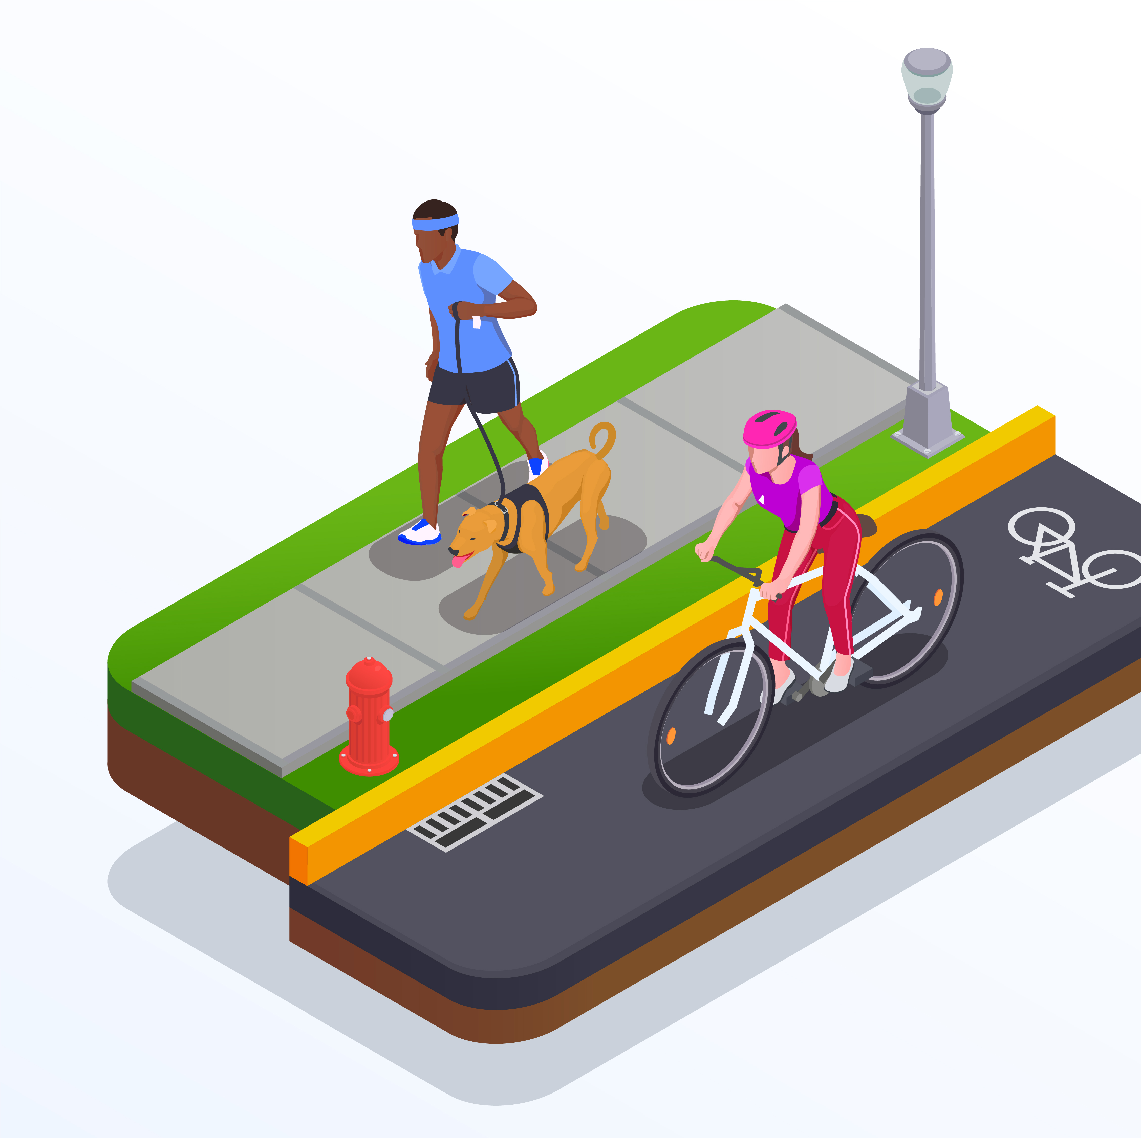
Target Users
Commuters in unfamiliar areas
Women traveling alone at night
Elderly pedestrians
Recreational cyclists
Delivery workers & rideshare drivers
Urban planners & transport authorities
Notes:
We’re focusing on groups most affected by unsafe routes: commuters in unfamiliar neighbourhoods, women traveling at night, elderly pedestrians, cyclists, delivery workers, and even city planners who need safety data for decision-making.

Slide 5
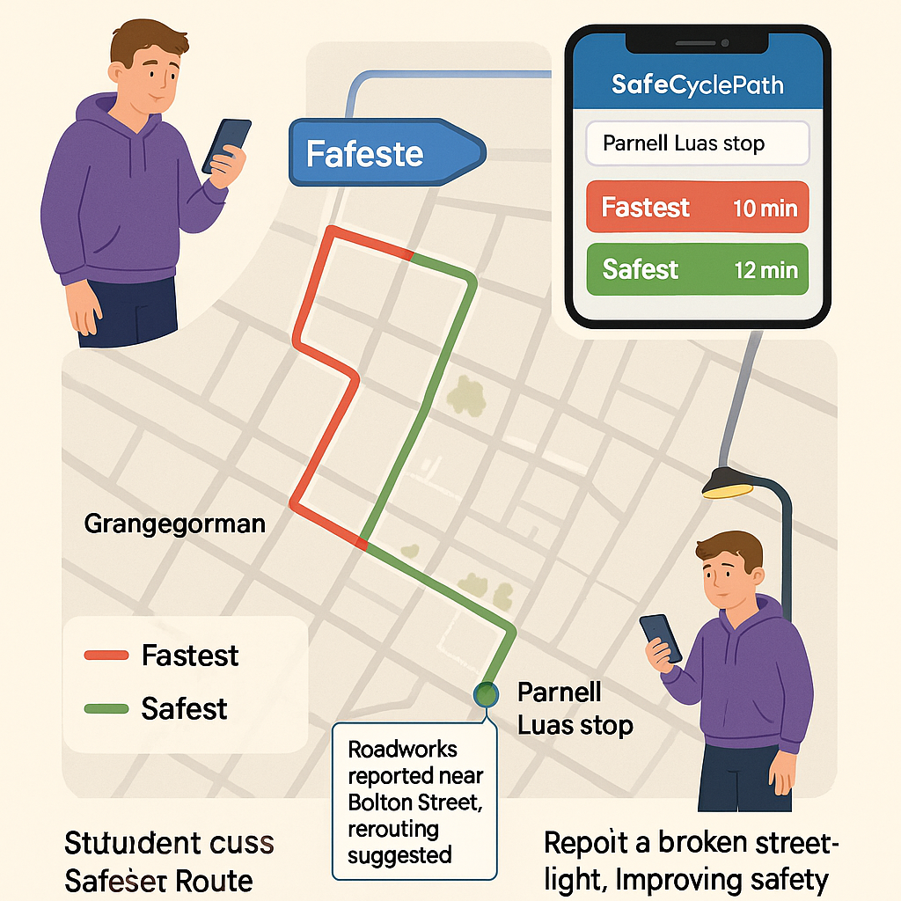
Use Case : TU Dublin student walking from the Grangegorman campus to the Parnell Luas stop in the evening
The student opens the SafeCycleRoute app and fills in the ‘going to’ field.
The app generates and suggests two route options: Fastest and Safest.
The Fastest 🔴 route is about 10 minutes.
The Safest 🟢 is 12 minutes with only 2 minutes longer.
The student’s map shows that the fastest route takes the student through a number of poorly lit side streets and an area marked as a unsafe hotspot 🔴.
The student chooses the Safest Route 🟢 which is likely the better route as it along better lit streets which has high pedestrian traffic and many crosswalks.
During the student journey, real-time alert pops up from the map: Roadworks reported near Bolton Street, rerouting suggested.
The student arrived safely at the Parnell Luas stop and he/she reports a broken streetlight, improving safety data for future users.
Notes:
This scenario demonstrates how our app works in practice. The student opens SafeCycleRoute, compares the fastest and safest routes, and chooses the safer one with minimal extra time. Real-time alerts keep the student updated about roadworks, and they can contribute by reporting hazards like broken streetlights. This shows how the app not only guides users but also improves safety data over time

Slide 6
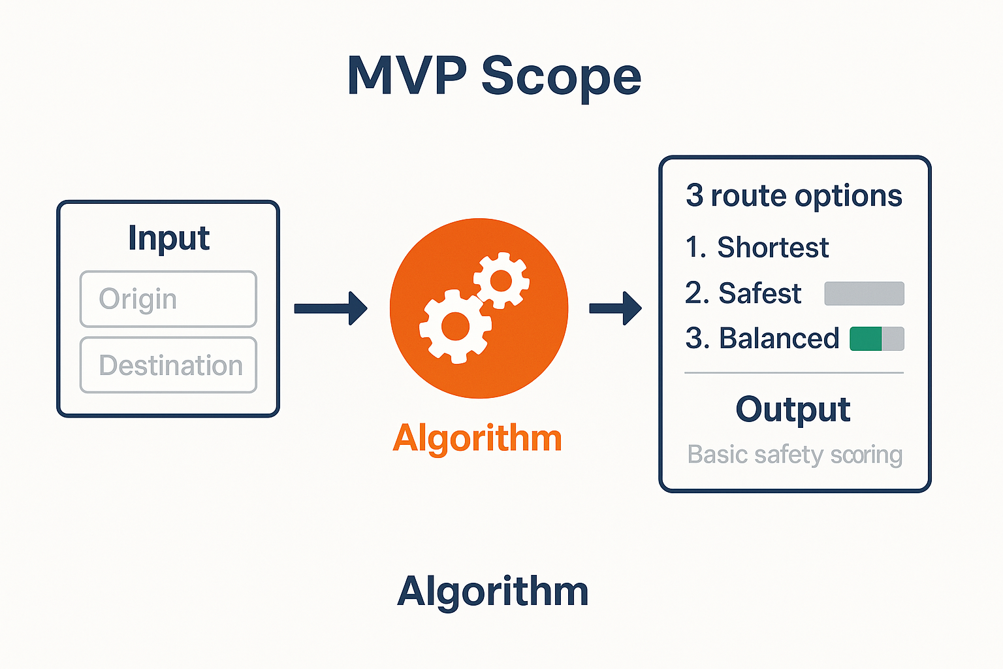
MVP Scope
Web app focused on Manhattan
Input origin-destination → 3 route options
Integrates NYPD crime data
Basic safety scoring
User feedback collection
Notes:
For our minimum viable product, we’re focusing on Manhattan. The system will be web-based and provide three route options using NYPD crime data. We’ll include simple safety scoring and collect user feedback to refine the model.
Input origin–destination → 3 route options
What it means: In the MVP, the user will type in a start point (origin) and an end point (destination), just like Google Maps.
The system will then generate three route options:
Shortest/Fastest Route (optimized for time)
Safest Route (optimized for safety score, even if longer)
Balanced Route (a compromise between time and safety)
Example: Walking from Grangegorman Campus → Parnell Luas Stop:
Fastest: 10 min (but through unsafe side streets)
Safest: 12 min (better lighting, safer area)
Balanced: ~11 min (mix of both)
Basic safety scoring
What it means: Each street segment is given a safety score based on simple rules in the MVP.
For now, the MVP will mainly use crime density data (NYPD incidents 2022–2024).
Streets with more reported incidents = lower safety score 🔴
Streets with fewer incidents = higher safety score 🟢
In later versions, more factors (lighting, crosswalks, bike lanes, weather) will be added, but MVP keeps it simple → crime data only.

Slide 7
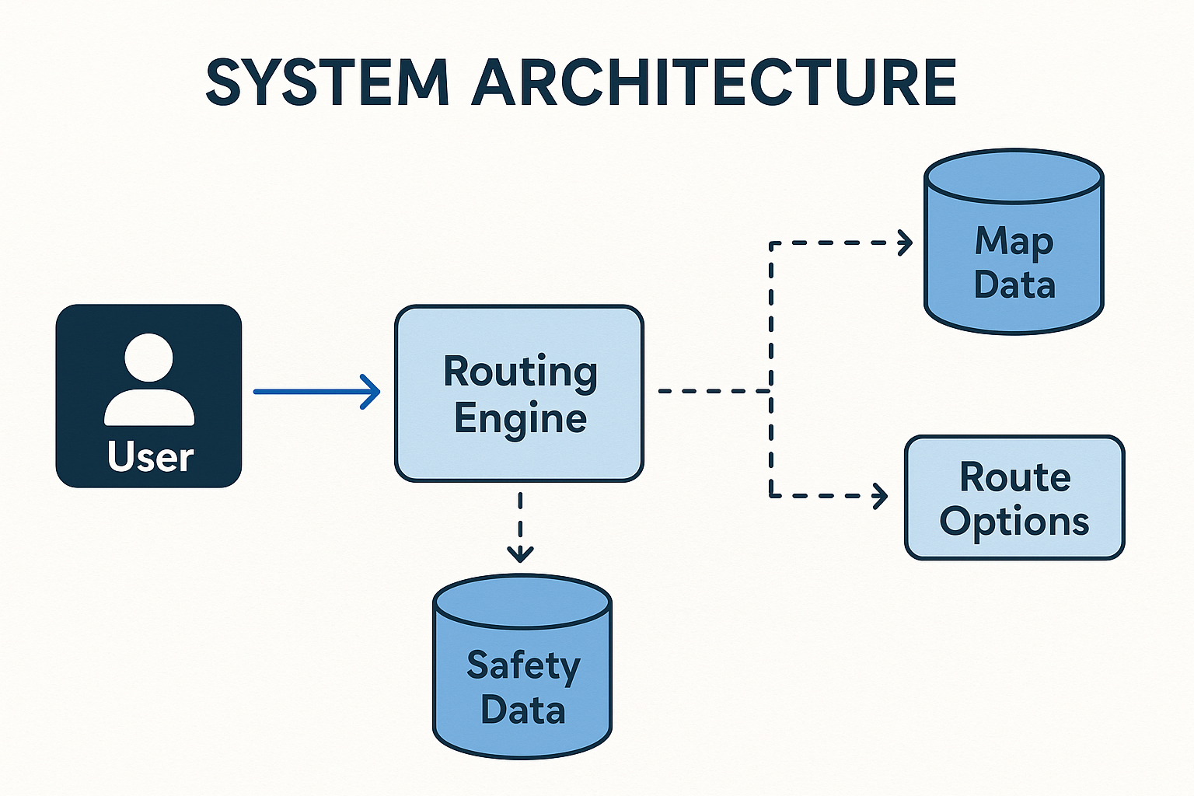
Frontend:
React.js, Leaflet.js map
Backend:
Flask/Django REST API, PostgreSQL/PostGIS
Python routing engine (NetworkX, OSMnx)
ML pipeline (scikit-learn)
Data Sources:
NYPD API, OSM, NYC Open Data, User hazards, Weather
Notes:
This architecture shows how the system works. The user interacts through the frontend, sending a request to the routing engine. The backend processes data from multiple sources — map data, crime and safety data, weather, and user reports. The routing engine applies the safety scoring algorithm and generates three route options: shortest, safest, and balanced. This modular design allows us to expand with more safety factors later
Frontend: React + Interactive Map (Leaflet/Mapbox)
Why React? It’s the most widely used modern web framework → fast, component-based, responsive design. Ideal for building a smooth UI.
Why an interactive map? Users need to see and compare routes visually. Leaflet.js/Mapbox are open-source, customizable, and perfect for real-time mapping.
Backend: Flask or Django (REST API)
Why Flask/Django? Both are Python-based, which makes integration with machine learning libraries straightforward.
Django = more structure, built-in admin, and faster for bigger systems.
Flask = lightweight, flexible, good for MVPs.
Both can expose a REST API → frontend and backend communicate easily.
Database: PostgreSQL + PostGIS
Why PostgreSQL? Reliable, open-source, scalable relational database.
Why PostGIS extension? It adds spatial functions, meaning it can handle maps, routes, and geodata efficiently. Perfect for urban routing systems.
Routing Engine: NetworkX + OSMnx
Why NetworkX? It’s a Python library for graph-based algorithms (shortest path, weighted path). Streets are essentially graphs → nodes = intersections, edges = roads.
Why OSMnx? It integrates directly with OpenStreetMap to download and manage street networks. Saves development time and ensures accuracy.
Machine Learning: scikit-learn
Why scikit-learn? Mature ML library in Python, easy to prototype models for safety scoring. Ideal for MVP stage.
It allows you to test and adjust weights for risk factors (crime density, accidents, etc.) quickly.
Data Sources
NYPD Crime Data → to identify crime hotspots.
OpenStreetMap → free, detailed street networks (roads, bike lanes, pedestrian paths).
NYC Open Data (collisions) → accident-prone intersections.
User reports → crowd-sourced hazards (broken lights, potholes, unsafe areas).
Weather API → adds context (rain or snow increases risk).

Slide 8

Development Plan (SCRUM)
Sprint 1-2: Data pipeline & routing
Sprint 3-4: Safety scoring & frontend
Sprint 5-6: Validation & optimization
SCRUM: Daily standups, sprint planning, reviews, retrospectives
Project Management Tool: Jira for sprint boards and backlog tracking
Notes:
For project management, we will use Jira, which provides powerful sprint boards, backlog prioritization, and reporting tools. Jira will help us stay aligned with SCRUM methodology, track progress visually, and make collaboration smoother

Slide 9

Evaluation Plan
Quantitative:
Historical validation
Algorithm performance testing
Safety score validation
Qualitative:
Expert feedback
Literature comparison
Case study analysis
Notes:
We’ll evaluate the system in two ways.
Quantitatively, by comparing our routes against Google Maps, testing speed and reliability, and checking if our safety scores match expert assessments.
Qualitatively, we’ll consult with urban planners, compare with research, and analyse case studies of high-risk routes.

Slide 10
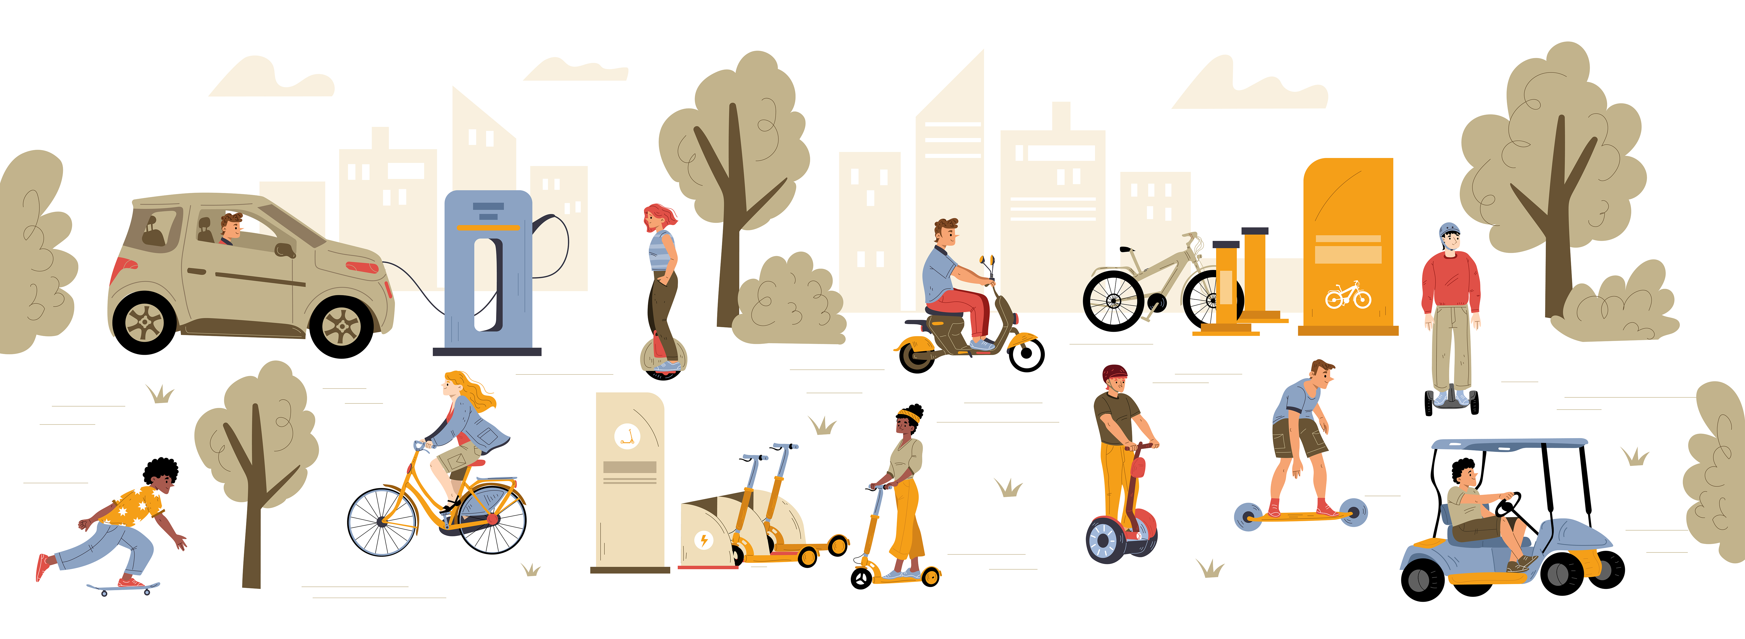
Future Enhancements
Expand to Brooklyn & other boroughs
Add more safety factors (lighting, bike lanes, weather)
Partnerships with transport authorities
Scale to other global cities
Notes:
After the MVP, we plan to expand to Brooklyn and other boroughs. We’ll add more safety factors, like lighting conditions and bike lane availability. Long term, the platform could scale to other cities and form partnerships with transport authorities.

Slide 11
Q & A
Thank you

